Slide 1

MSA 8020 Data Visualization: Final Project
By: Kaysi Castor, Ali Razavi, Ali Tavakolzadeh, Saqib Hameed, and Colin Morgenroth

Slide 2
Looking at COVID19 Globally and in the United States
Business Questions:
Which countries handled the pandemic better?
In the US which States Handled the pandemic better?
Datasets: Time series COVID 19 John Hopkins & NY Times

Slide 3
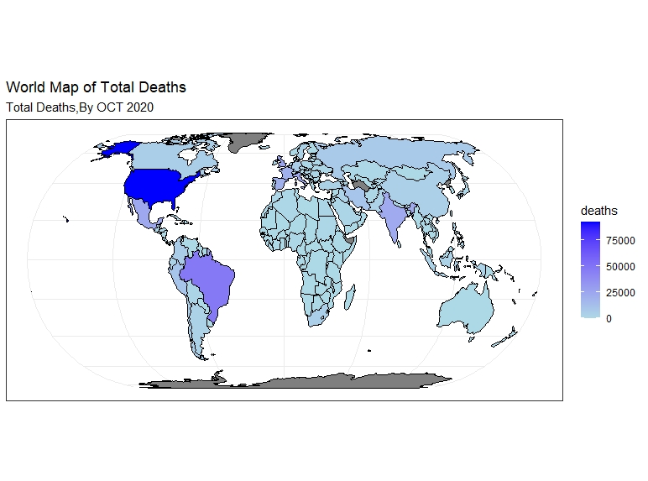

Slide 4
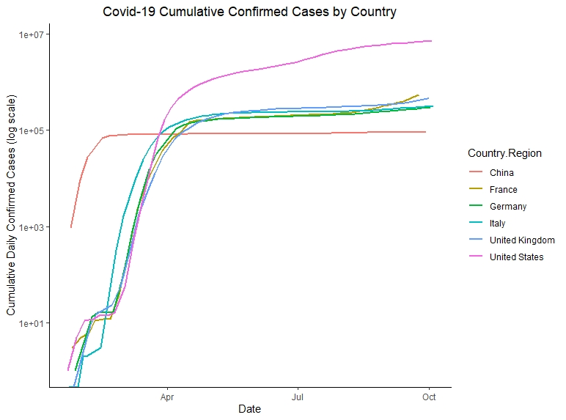
Cumulative Confirmed Cases By Country
There is significant growth in Daily cases before April
After April, most of the countries show steady growth except US.
It seems China has had the least new cases since March

Slide 5
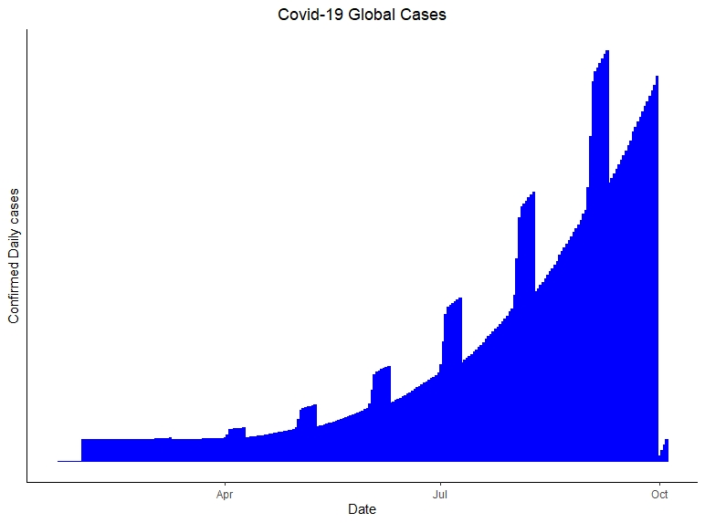
Cumulative Confirmed Daily Global Cases
From January to October you can see there is a consistent uphill hike in cases.
After April, the graph reflects volatility in the increases of cases during the beginning, middle, and end of the month.

Slide 6
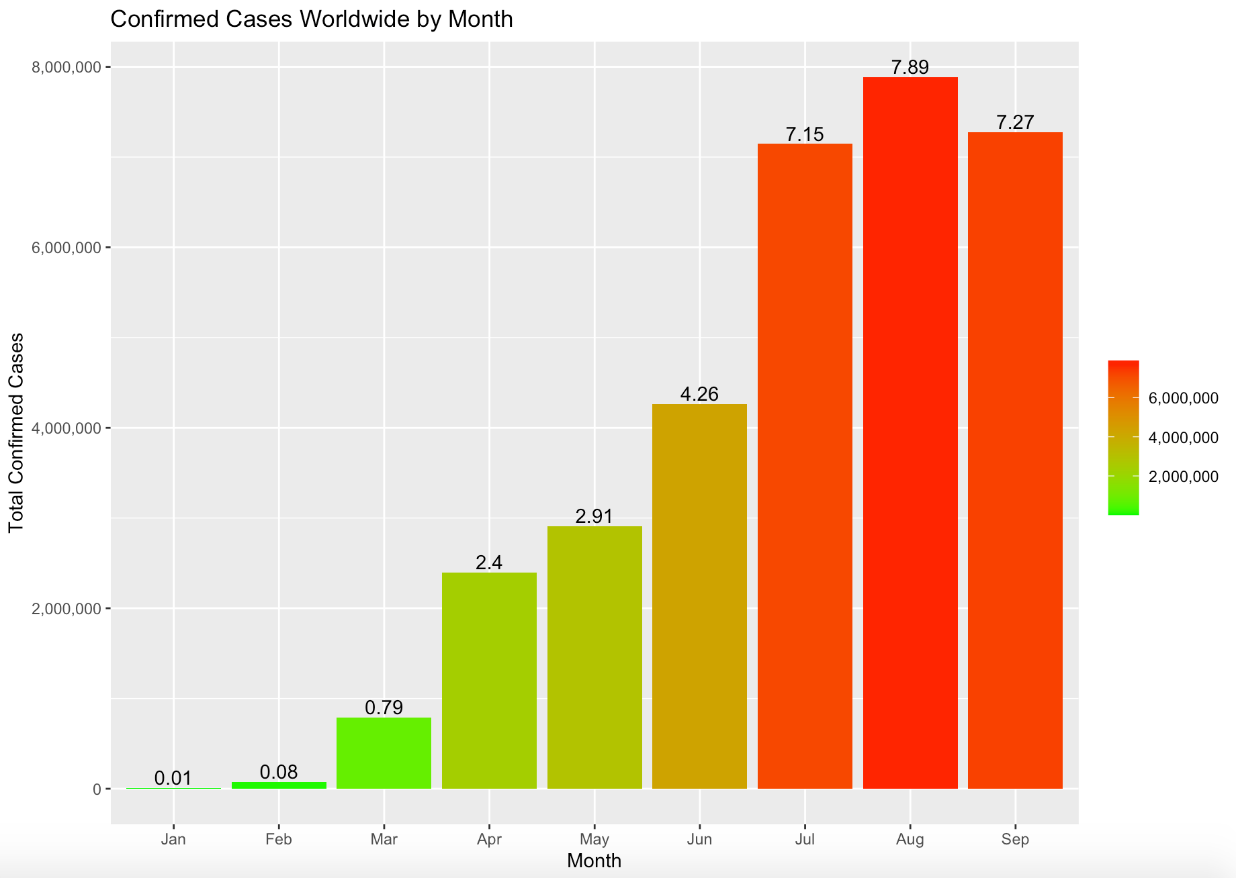
Second Wave begins to affect the world in July
Total Confirmed Cases increased by 67% from June to July

Slide 7
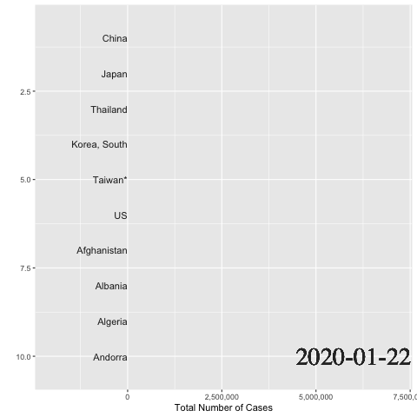
By July, Brazil, India and the United States become the most infected countries in the world
These three countries all shared common failures that led to the increased cases
Inadequate testing
Economic priorities over safety
Poor healthcare availability
Lack of spread prevention

Slide 8
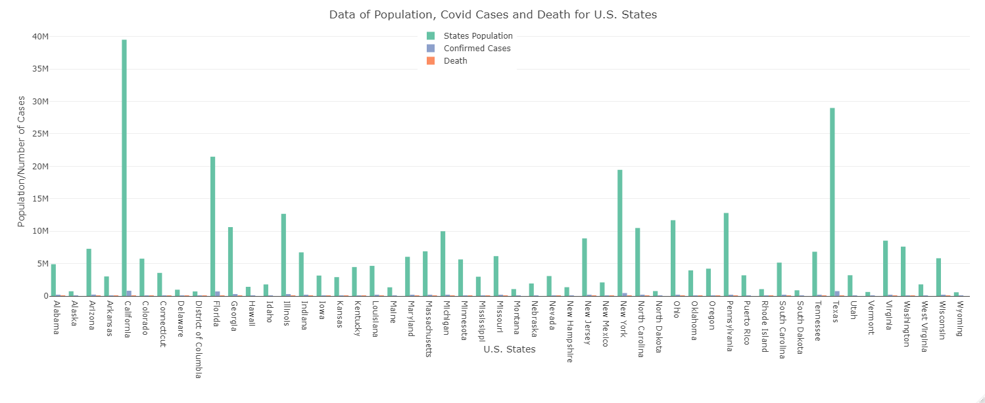
Covid 19 is one of the most contagious disease in human history
Total number of cases < 4% of Population
Good news!!!
Total number of deaths < 0.07% of Population
What would have happened if nobody cared about this pandemic?
The number of cases would be tens or even hundreds of million and we would have millions of deaths.

Slide 9
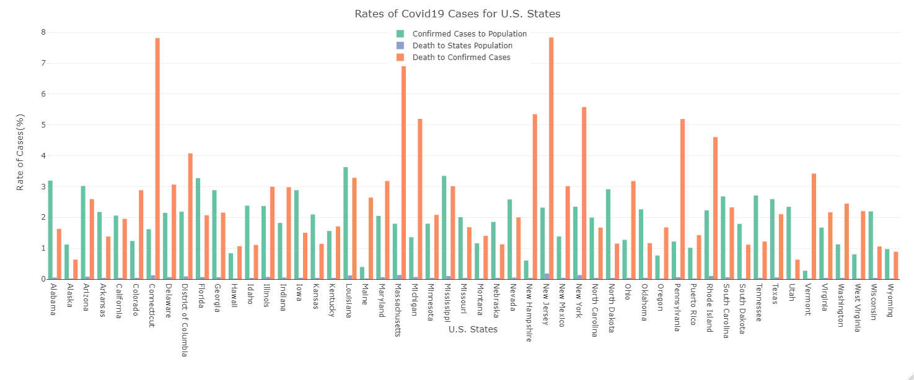
Total number of cases < 1% to 4% of Population
Some states have very high death to confirmed cases rates.
Death to confirmed cases rate for Conneticut, Massachusetts, New Jersey, New York, etc. have more than 5 percent
- Lack of Testing
- Higher population of vulnarable to Covid 19
- The healthcare facilities are not efficient as other states
Despite California and Texas are among top 5 populated states, their rates of deaths to confirmed cases are less than 3 percent which shows great testing capacity and healthcare system in these states.

Slide 10
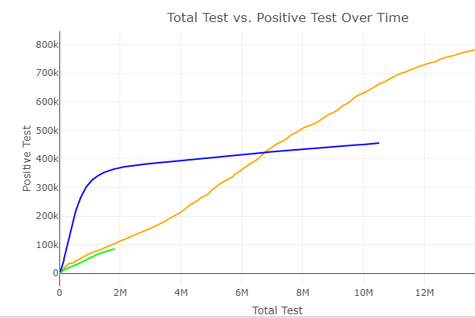
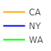
Washington reflects the hardest hit of the three states during February to mid-March.
New York had the most cases from mid-March to late-July.
California has the most test given and positive cases of the three states from late-July to the present as well as overall.
https://rpubs.com/cmorgenroth1/670678

Slide 11
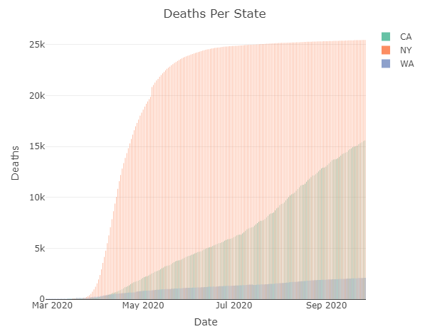
Population Size of States:
Washington: 7.615M
New York: 19.454M
California: 39.512M
When looking at the population sizes listed above NY was hit harder with deaths than California or Washington
https://www.census.gov/quickfacts/fact/table/WA,CA,NY/PST045219

Slide 12
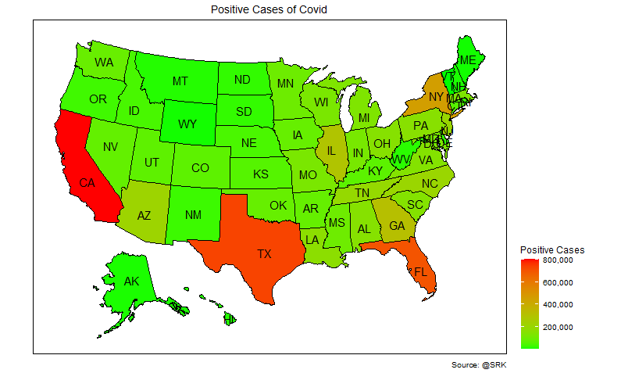
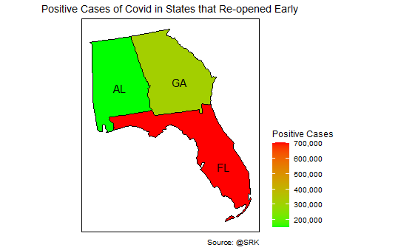
Looking at the positive cases for the Unites States we can see that the most populated states have a high number of positive cases. Looking that the three states that reopened earliest we can see that Florida, which is a tourist destination was indeed a hot spot for positive cases. (positive cases FL-700564)AL –152321 GA-314685)
Positive US Cases of COVID19
Early Re-Opened States Cases COVID19

Slide 13
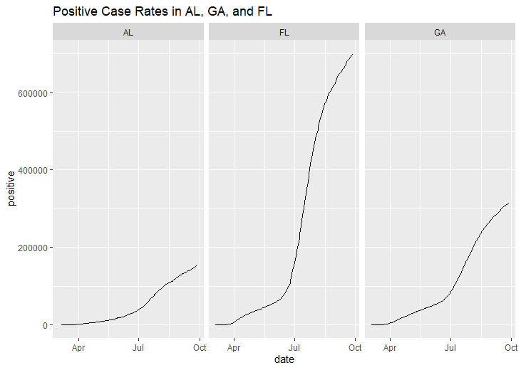
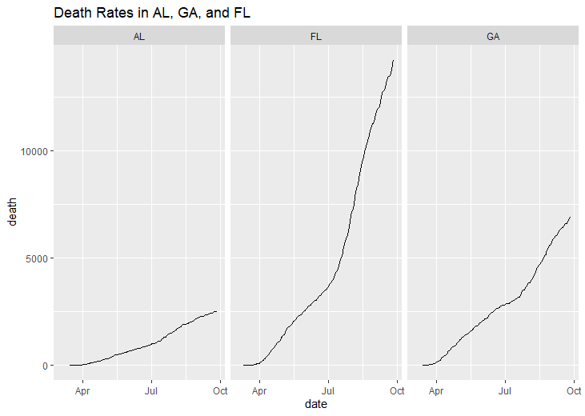
A closer analysis of those same three states shows a surge in positive cases and deaths beginning in July. This was after the states reopened through phase 2 and in Florida's case through phase 3 and into phase 4. July saw the largest increase in new cases as travel between and through states recommenced kicking off the second wave.
Positive Cases AL, GA, FL
Death Rates AL, GA, FL

Slide 14

In conclusion:
The Second Wave of Cases hit on a Global level from July to the Present. This jump could be due to a myriad of reasons, but one of the largest contributing factor is going to be more testing is being done globally.
Restrictions being lifted and travel allowed to resume is likely another factor in the second wave's numbers jumping so quickly.
South Korea and New Zealand are the countries that handled the outbreak the best, while the US is the country that handled this the pandemic the worst.

